Slide 1

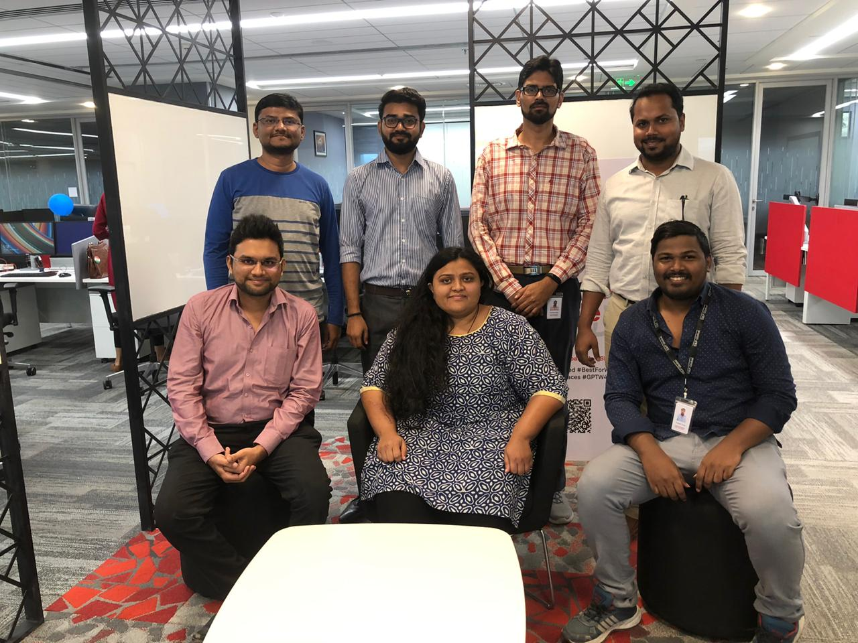
IFP Innovation – BriefIT (Text Summarization)
ESG
Team members details [ Name, Division, Location ]
JVKD Praveen, ESG, AMD
Bhargav Pandya, ESG, AMD
Preetinder Singh, ESG, AMD
Mehulkumar Vora, ESG, AMD
Avinash Kumar, ESG, AMD
Bhavi Sheth, ESG, AMD
Manan Shah, ESG, AMD
Insert a I3Hackathon Event team’s group photo
Project Owners details [ Name, Division, Location ]
Jeetu Bhagchandani
Avinash Pathange
Product Owners details [ Name, Division, Locaion ]
25th November, 2019
Permission to reprint or distribute any content from this presentation requires the prior written approval of S&P Global. Not for distribution to the public.
Notes:
You can add an image from the S&P Global brand image library: https://thehub.spglobal.com/docs/DOC-110896

Slide 2
i3Hackathon selected idea executive summary
IFP Innovation – BriefIT (Text Summarization)
The primary motive of ‘team ESG’ behind building text summarizer is to provide tractability in providing a synopsis of text. Our team applies extractive method of summarizing text, which involves the selection of phrases and sentences from the source text to write summary. We take several tools/apparatus into consideration such as Python 3.6, Jupyter notebook, and NLTK – an NLP library in python
4 steps are involved in text précising :
Remove stop words (which does not add value to the text)
Creation of frequency table of words from text
allocating score to sentences based on words and the frequency table
In final summary, identifying score of every sentences which are above a certain threshold
Based on the requirement, an another advantage of this summarizer, a user can modify threshold criteria in the code. By applying new threshold, user can curtail or lengthen the number of words in final summary
Notes:
What challenge or problem does this project address and for whom?
What key business drivers might be impacted by this project?
Does this project address an existing business challenge? If so, please expand.
What's the business context for this project in simple terms? What is the project looking to achieve? Why are you doing this project?

Slide 3
Please access the video from below link
https://web.microsoftstream.com/video/80384fc3-2d28-43e1-baa7-adfed38ae079?list=studio
Notes:
Is the problem you are proposing to address with your project being served by our competitors today? If so, provide details you have on our competitors' solutions.

Slide 4
Questions?
Source code path
https://github.com/jdurgapraveen/Text-summarizer/blob/master/ESG
Jalasutram, Venkata Kanaka Durga Praveen
Sr. Data researcher - I
T: +91 8125889080
vjalasutram@spglobal.com

